Slide 1
Week 5 Show & Tell
Joel Felix Quadras (D22125093 - DS) Cheril Mariam John (D22124272 - ASD) Mountdenyraj Chelladurai Nadar (D22124430 - ASD) David Ayang (D21127639 -ASD)
Notes:
Joel

Slide 2

Feature Selection Considerations
Notes:
cheril

Slide 3
Dyslexia friendly rules
1. Fonts styles and size
Use sans serif fonts like Arial, Comic Sans, Verdana, Tahoma, etc. These fonts appear less crowded.
Font size should be 12-14 point or equivalent. Some readers with dyslexic may request a larger font.
Increase inter-letter spacing by about 35% of the average letter width.
Ensure inter-word spacing is at least 3.5 times the inter-letter spacing.
Larger line spacing (about 150%) can improve readability.
Avoid Underlining and Italics as these styles can make text appear crowded. Use bold for emphasis instead.
Avoid using capital letters for continuous text. Lowercase letters are easier to read.
Notes:
cheril

Slide 4
Dyslexia friendly rules
2. Headings and Structure
Use headings and styles to create a consistent structure to aid navigation.
For headings, use a font size that is at least 20% larger than normal text. Consider using bold for further emphasis.
Notes:
cheril

Slide 5
Dyslexia friendly rules
3. Colour
Use single colour backgrounds without patterns, pictures, or distracting elements.
Ensure sufficient contrast levels between background and text.
Use dark coloured text on a light background color like cream or soft pastel.
Avoid using green and red/pink, as these colours can be difficult for individuals with colour vision deficiencies.
Notes:
cheril

Slide 6
Dyslexia friendly rules
4. Layout
Left-align text without justification for even spacing between words.
Avoid using multiple columns.
Use white space to declutter near text and group related content.
Incorporate regular section headings and include a table of contents for long documents.
Notes:
cheril

Slide 7
Dyslexia friendly rules
5. Writing Style
Be concise and avoid long, dense paragraphs.
Write in simple, clear language using everyday words.
Utilize images, flow charts, and graphics to support text.
Consider using bullet points and numbering for better comprehension
Minimize the use of jargon and abbreviations. When necessary, provide a glossary.
Notes:
cheril

Slide 8
Functionalities
Notes:
Cheril

Slide 9



Upload Document
Doc , Docx
Txt , Rtf
XLS, XLSX
CSV, XML, XLSB
PPT, PPTX
CSV, XML, XLSB
Technological Solution
Uploading the file via a REST API Endpoint and loading it to an AWS S3 Bucket to store it.
Notes:
cheril

Slide 10

Parse Document
Technical Solution
Uploaded file will be passed through a parser to read all the data and meta data of the file.
This data will be used to understand the various accessibility issues in the document.
Notes:
cheril

Slide 11
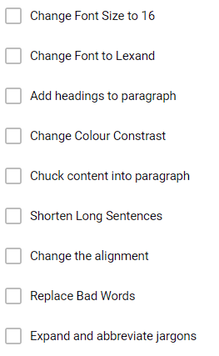
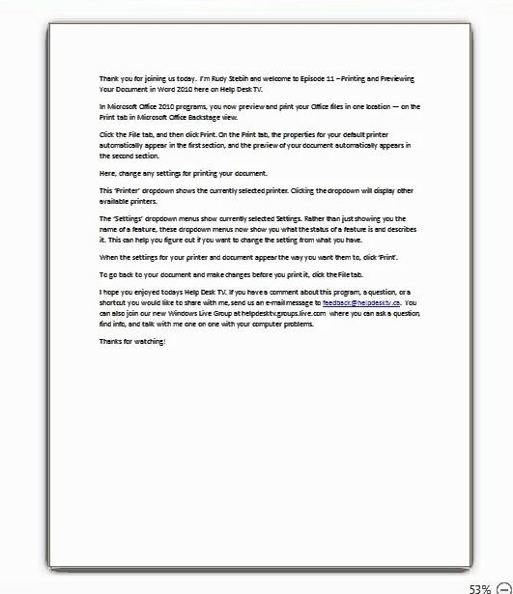
Display Document
Technical Solution
Display the uploaded file to the user with all the core and the advanced features listed.
User can select and unselect the features he would like to implement
Notes:
cheril

Slide 12
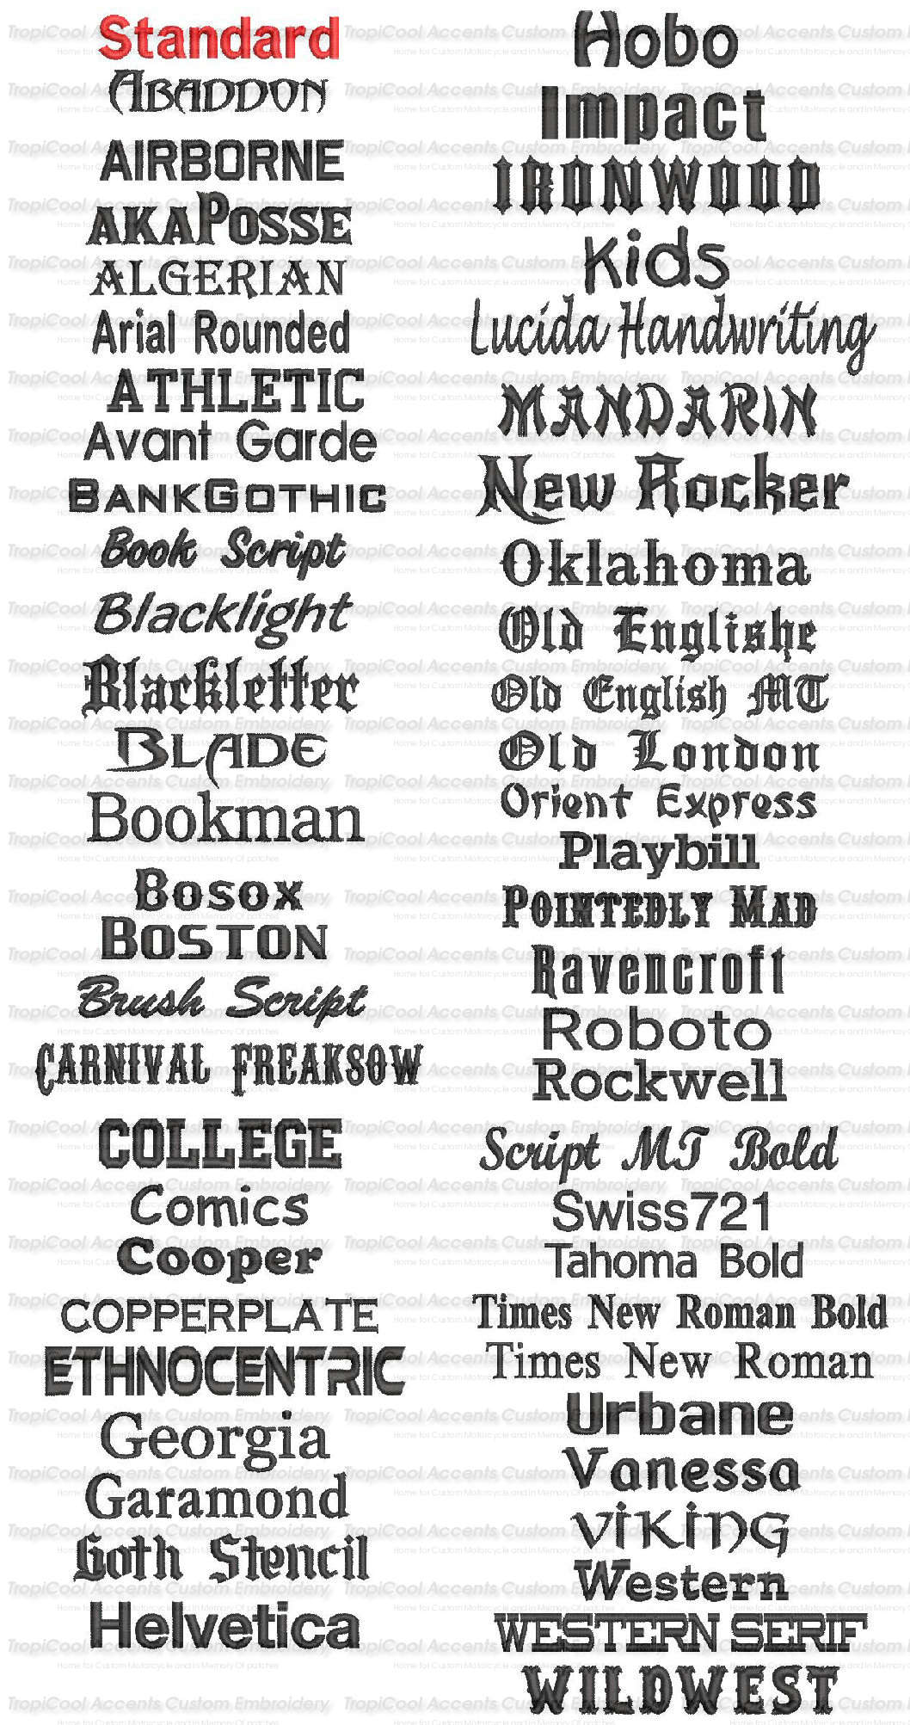

Font style
Technical Solution
Parse the metadata
Change the entire text from existing to dyslexic friendly fonts OR
Change the text of non-friendly text fonts to dyslexic friendly fonts.
Arial
Comic Sans MS
Verdana
Notes:
deny

Slide 13
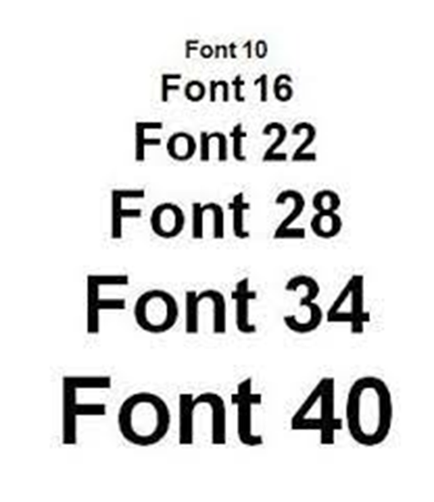
Font size
Technical Solution
Parse the metadata
Increase the font of the text in the entire document if the text is too small for readability for a user with dyslexia.
Notes:
Deny

Slide 14
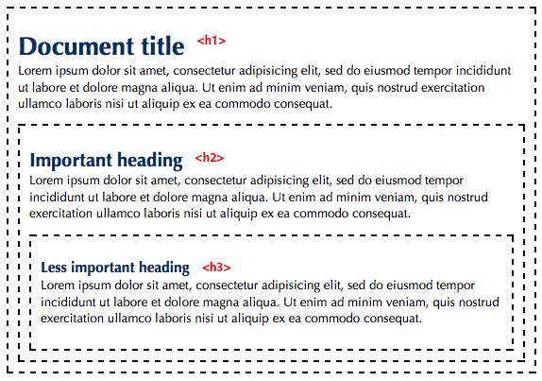
Headings
Technical Solution
Parse the metadata.
Explore ML Techniques to Identify where headings should be added in the Document and what the heading should say.
Notes:
Deny

Slide 15
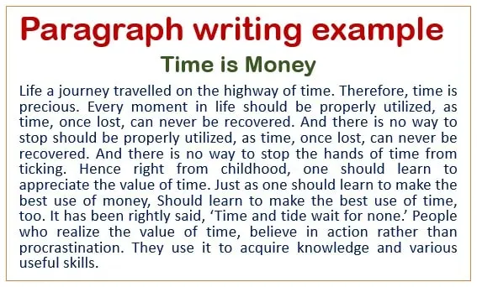
Paragraph
Technical Solution
Parse the metadata.
Explore ML Techniques to chunk the content in the documents into paragraphs if the document has long or no paragraphs.
Notes:
Deny

Slide 16
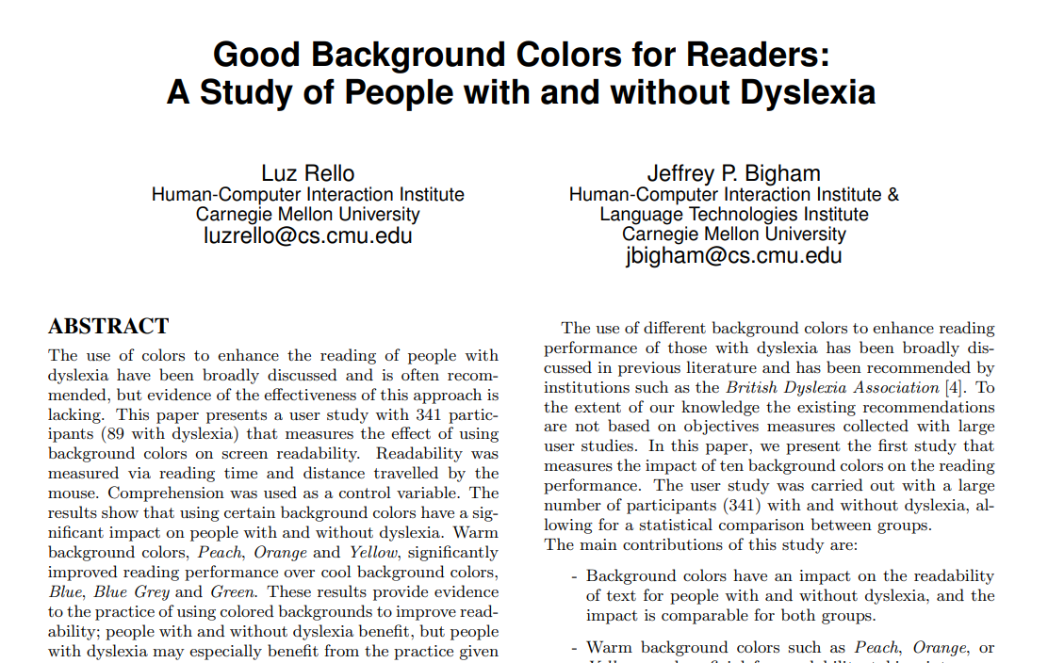
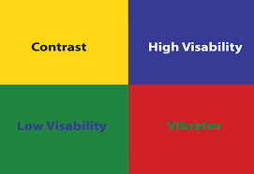
Colour - Contrast
Technical Solution
Parse the metadata.
Subtract the colour-coded values of the font and background and make sure the contrast is high.
Notes:
Deny

Slide 17
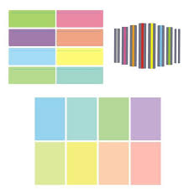
Colour - Dyslexia
Technical Solution
Parse the metadata.
Subtract the colour-coded values of the font and background and make sure the contrast is high.
Notes:
deny

Slide 18
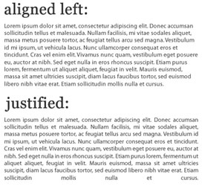
Layout Alignment
Technical Solution
Parse the metadata.
Change justification to left unless otherwise justified in the user's profile.
Notes:
deny

Slide 19
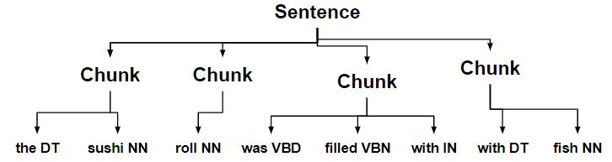
Layout – Sentence chunking and Sentence splitting
Technical Solution
Parse the metadata
Use ML techniques to Shorten and divide the sentences
Look at NLP techniques
Notes:
deny

Slide 20
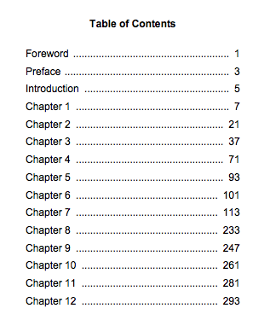
Layout - Table of Contents
Technical Solution
If no TOC and the document is longer than 10 Pages recommend, they add a TOC
Notes:
deny

Slide 21

Bad Words
Technical Solution
Replace the Bad words with a better alternative while conveying the same message.
NLP will be used to replace the bad words.
He is a dick.
He is an Idiot.
Notes:
david

Slide 22
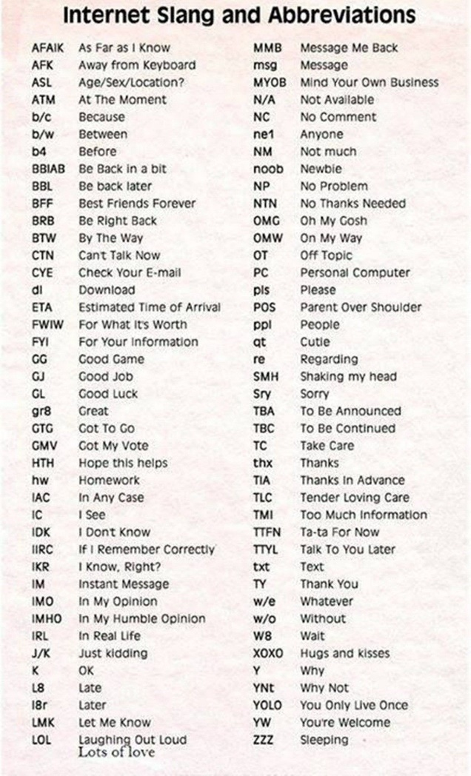
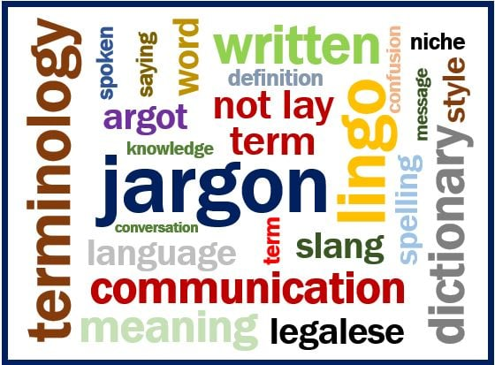
Expand Abbreviations and simplify Jargons
Technical Solution
Use ML techniques to expand and abbreviate in the entire document.
Sentences with a lot of technical jargon will be simplified using ML Techniques. Sentences will be regenerated in simple language.
Notes:
david

Slide 23
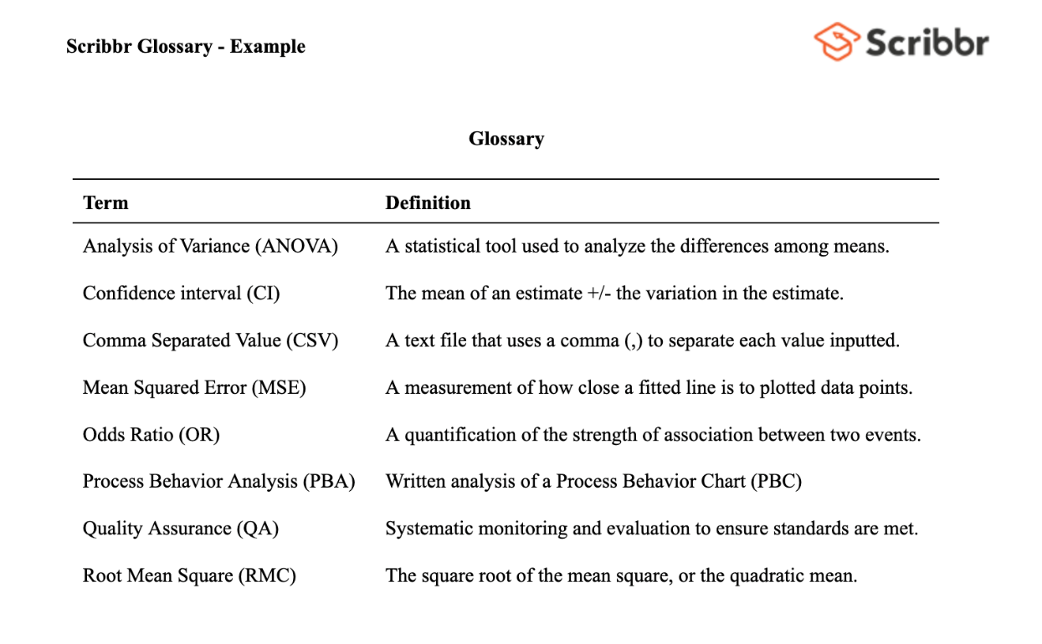
Glossary Auto-generation
Technical Solution
sentences that cannot Use ML Techniques to identify the jargon in the t be simplified and generate a Glossary for the word.
Notes:
Joel

Slide 24
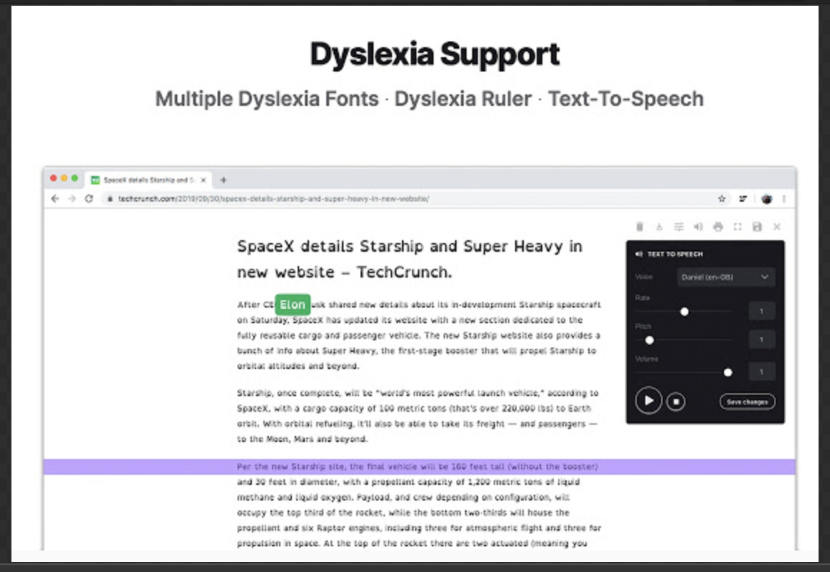
Dyslexia ruler with customisations
Technical Solution
Customization panel to alter the properties of the ruler. CSS and JavaScript will be used to solve this issue.
Notes:
Joel

Slide 25
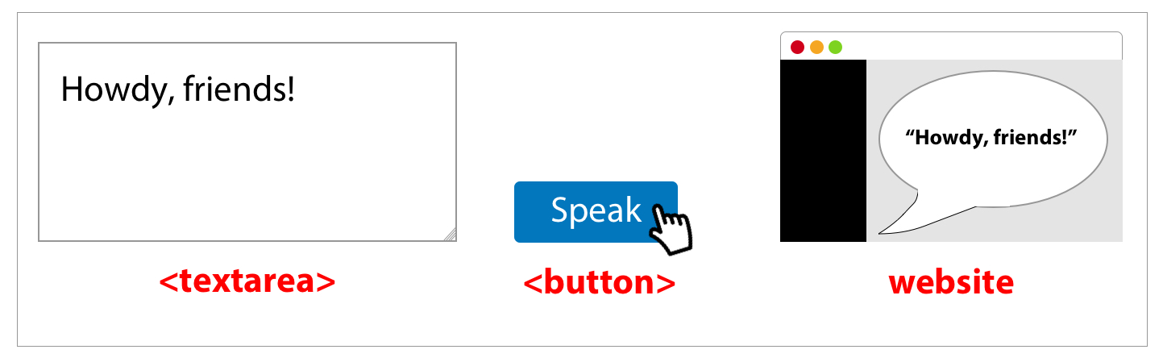
Text to speech
Technical Solution
Using Web Speech API in JavaScript as a solution
Notes:
Joel

Slide 26

Screen Reader
Technical Solution
Using CSS and JavaScript this issue can be resolved.
Notes:
Joel

Slide 27
Feature set - Difficulty assessment
Feature | Difficulty | Type
Upload File | Easy | Core
Display File | Medium | Core
Parse File | High | Core
Font Style | Easy | Core
Font Size | Easy | Core
Headings | Medium | Advanced
Paragraph | High | Advanced
Colour - Contrast | Easy | Core
Colour - Dyslexia | Medium | Core
Layout - Alignment | Easy | Core
Notes:
Joel

Slide 28
Feature set - Difficulty assessment
Title | Difficulty | Type
Layout – Sentence chunking and Sentence splitting | High | Advanced
Layout - Table of Contents | Medium | Advanced
Bad words | High | Advanced
Image labelling | Medium | Advanced
Expand Abbreviations and simplify jargon | High | Advanced
Glossary Auto-generation | High | Advanced
Dyslexia ruler with customizations | Easy | Advanced
Text to Speech | Medium | Advanced
Screen Reader | Medium | Advanced
Notes:
Joel

Slide 29
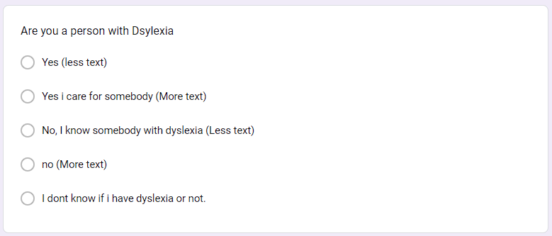
Survey
The survey is divided into 5 user categories based on our initial assessment.
Person with dyslexia
A person who cares for someone with dyslexia
A person who knows someone with dyslexia
No, I don’t have dyslexia
I don’t know if I have dyslexia or not.
https://dyslexia-awareness.com/dyslexia_questionnaire.html
https://dyslexiaida.org/screening-for-dyslexia/dyslexia-screener-for-adults/
Notes:
Joel

Slide 30
Development and UX
Notes:
cheril

Slide 31
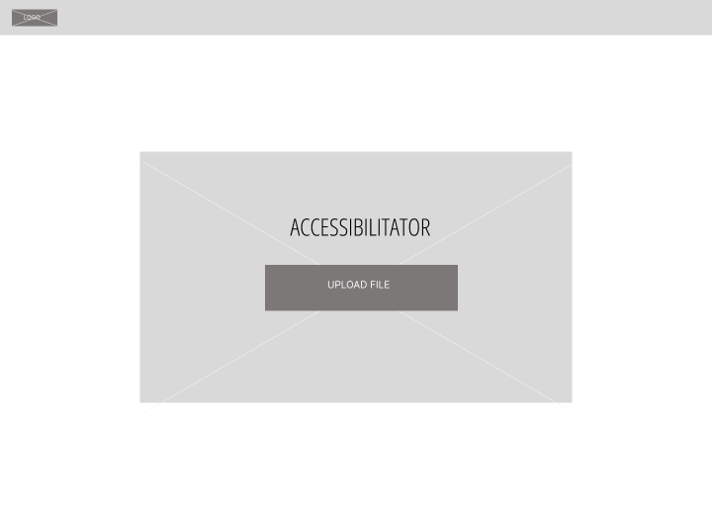
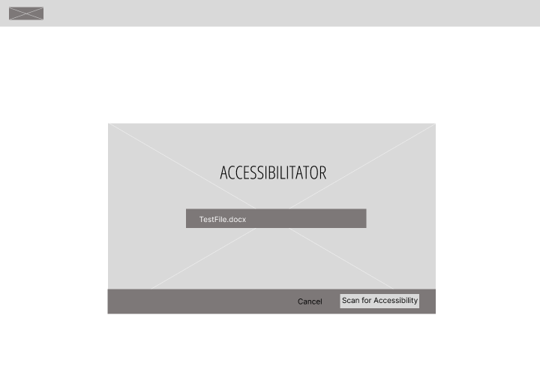
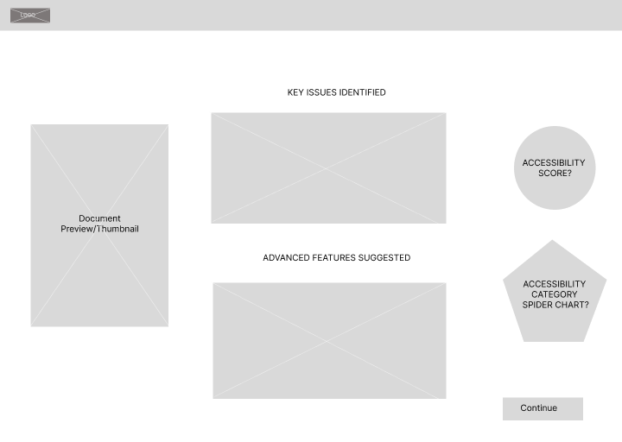
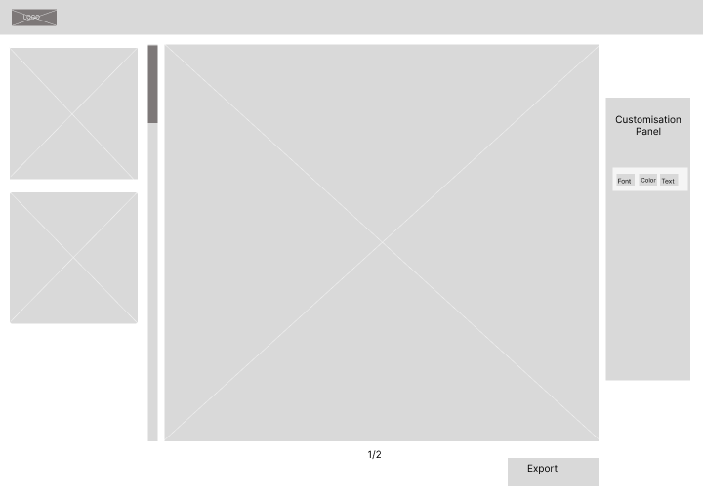
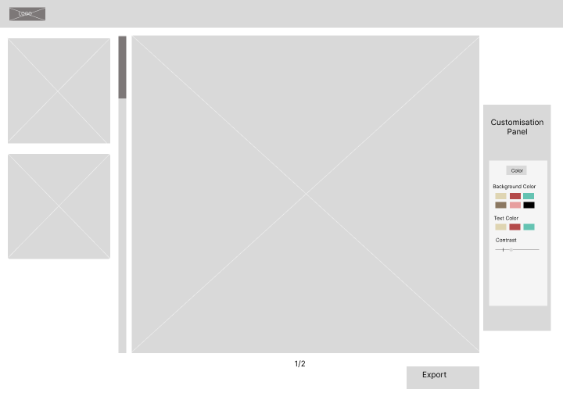
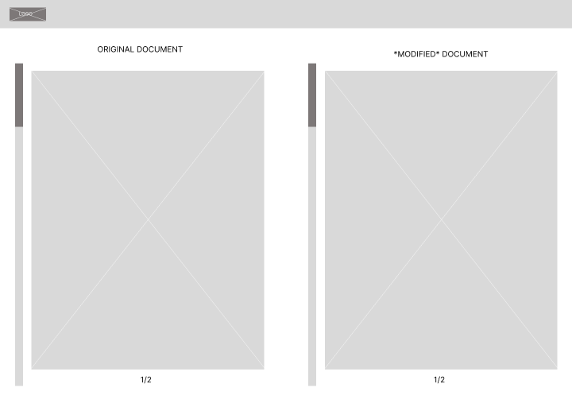
UI Design - Wireframes
Notes:
david

Slide 32
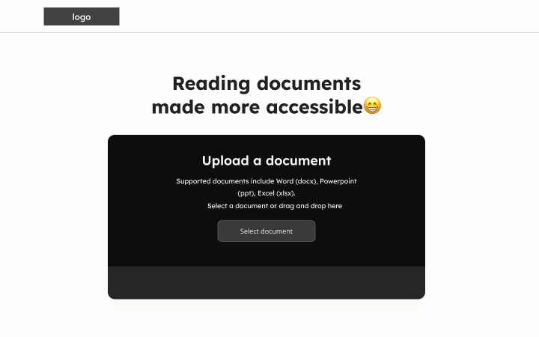
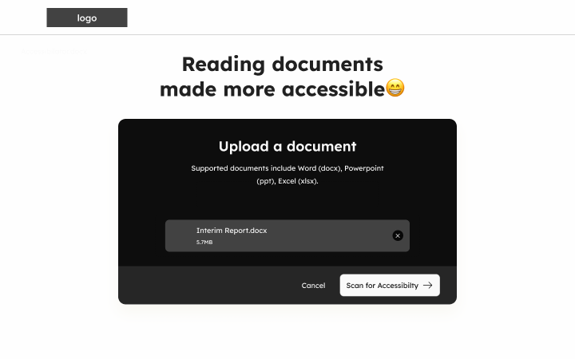
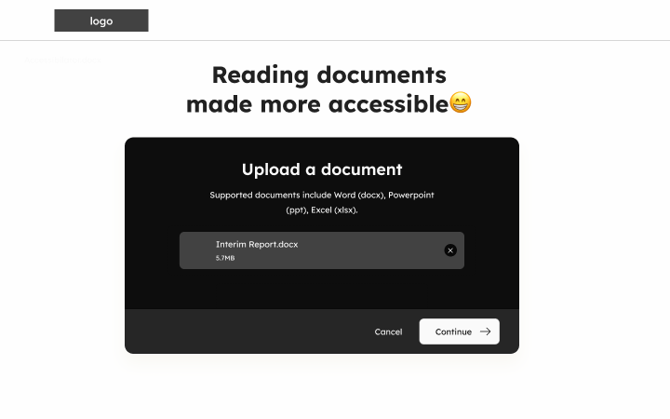
UI Design – Medium Fidelity
Figma UI Link
Notes:
david

Slide 33
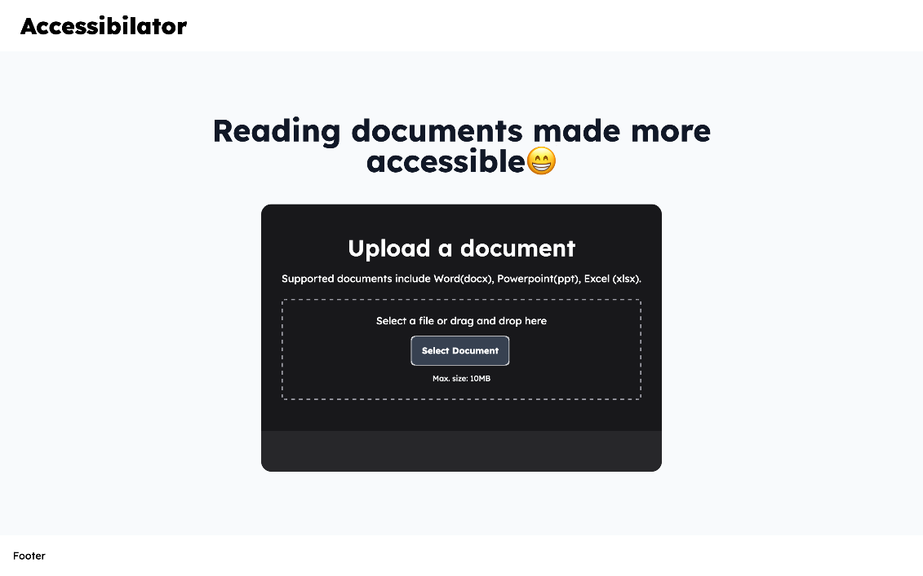
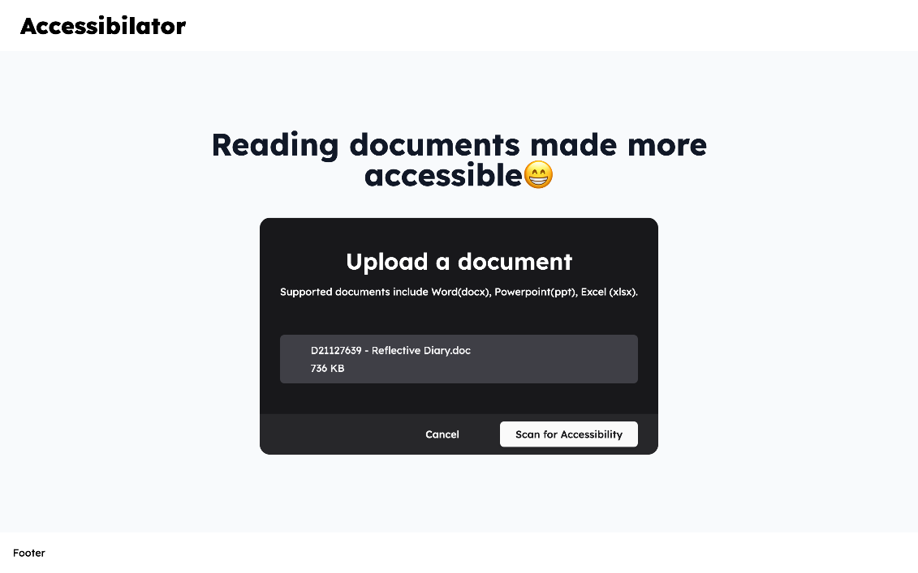
App Screenshots
Notes:
David

Slide 34
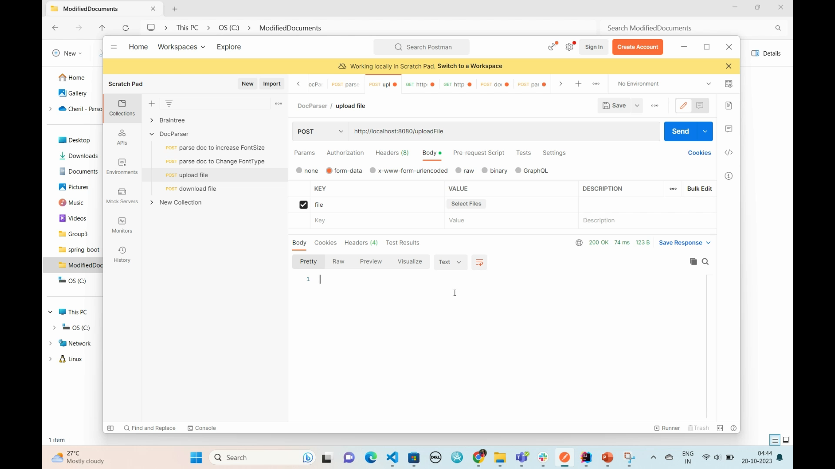
Backend API demo
Notes:
Cheril

Slide 35
Show and Tell Questions
How are the ASD and DS team members communicating? (Joel)
Slacks for most team-related communication.
GitHub for everything code-related.
Azure Boards for project management-related.
In-person meetings for nuanced collaboration and learning.
Calls for immediate connection with teammates.
Notes:
joel

Slide 36
Show and Tell Questions
Is there any Knowledge Sharing between ASD and DS parts of the teams (Deny)
Git, Github, Azure Boards DevOps (David, Cheril, Deny)
AWS Console, Azure Boards, Tailwind (David, Deny, Cheril)
Figma, UI/UX and Design Thinking (Cheril, David, Deny)
Amazon Sagemaker, NLP, ML Techniques (Joel, Deny, David) .
Data Science aspects (Joel)
Spring Boot, API, System Design (Cheril, David)
Notes:
joel

Slide 37
Show and Tell Questions
GitHub – Who is managing it or have oversight of what is being done on it (each week) (David)
David has taken the responsibility of managing the GitHub. We currently have branch protection rules in place to prevent merging into the main branch without approval from another team member.
What do you think the key milestone that you have yet to overcome as a team? (Cheryl)
From a technical standpoint, we consider the restructuring of sentences and paragraphs to be the most challenging task that we must tackle. Given that our team comprises only one data science member, there exists a learning curve for each of us to enhance our contributions to development. As a team, we must collectively embrace adhering to the outlined process and taking ownership of each of our tasks.
Notes:
david

Slide 38
Show and Tell Questions
What are the 3 key learnings you have taken away from the process so far? (Joel)
An in-person working environment mixed with virtual meetings helps the team be more productive.
Dyslexia is a complex condition, and we have discovered that most of major problems only require easy technical solutions and vice versa.
Communication is key in ensuring everybody is on track.
How are you dealing with the day-to-day problems you have as a team? (Deny)
Communication
In-person collaboration
Breakdown of tasks
Daily standup/discussions
Team evaluation
Notes:
joel

Slide 39
Show and Tell Questions
What changes to the team dynamics are required for the remainder of the project? (David)
Document individual research and increase GitHub contributions.
Prioritise more in-person meetings and knowledge-sharing sessions.
Communicate technical/personal issues/difficulties earlier.
Frequent communication with stakeholders such as professors, and users to be able to build a better application.
Document research done by the team members so there’s more visibility.
Notes:
david

Slide 40

Thank you!
Any Questions??
Notes:
end

